Slide 1

Reception Welcome Meeting
01.10.25

Slide 2
The Reception Team
Reception leader: Mrs Edwards
Ash
Class teachers: Mrs Taylor and Mrs Rudge
LSAs: Mrs Morley and Mrs Meikle-Day
​
Beech
Class teacher: Miss Chambers
LSAs: Mrs Craven and Mrs Pitts​
​
Oak
Class teacher: Mrs Edwards and Mrs Bayjoo
LSAs: Mrs Jelley and Mrs Wallace

Slide 3
Early Years Foundation Stage Framework
Statutory government framework for all early years providers.
Every child is unique
Children become independent through positive relationships
Children develop well in enabling environments
Children learn and develop and different rates
Seven Areas of Learning:
  Communication and Language
  Personal, Social and Emotional Development
  Physical Development
  Literacy
  Mathematics
  Understanding the World
  Expressive Arts and Design
At the end of the EYFS, there are the Early Learning Goals that children are expected to achieve. Assessed at the end of Reception.
Notes:
Children develop quickly in the early years- a child’s experiences in this time has a major impact on future life chances (EYFS).
“good parenting and high quality early learning, together, provide the foundation for children”- partnership working is important all through your child’s education, but especially at this point when children are transitioning into school.
3 prime areas-
Communication and Language
Personal, Social and Emotional Development
Physical Development
4 specific areas-
Literacy
Mathematics
Understanding the World
Expressive Arts and Design

Slide 4
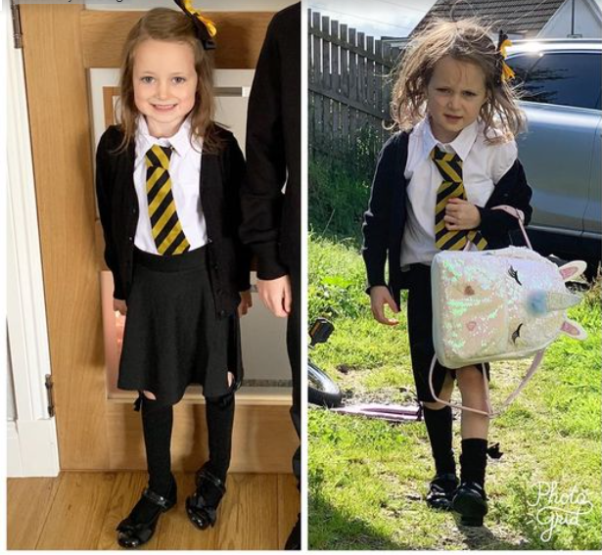
How children learn in Reception
Characteristics of Effective Learning
Playing and exploring (engagement) - children investigate and experience things, and ‘have a go’
Active learning (motivation) – children concentrate and keep on trying if they encounter difficulties, and enjoy achievements
Creating and thinking critically(thinking) – children have and develop their own ideas, make links between ideas, and develop strategies for doing things
Characteristics of effective learning
Play
First hand practical experiences
Problem solving
Teamwork
Notes:
Characteristics of effective learning- shape ‘how’ children learn rather than ‘what’ they learn. We want to set your children up to be successful learners throughout all of their education and life beyond school.
Playing and exploring- show a particular interest, often playing with what they know (rather than standing around not sure what to do). They may draw on their own experiences in play, for example playing in the roleplay area/ playing schools. They may also have a go at something new and try new experiences.
Active learning- not easily distracted, paying attention to details, concentrating when the activity interests them. Resilience. Believe that effort will pay off. Bounce back after difficulties. Proud of process not just the result. Children enjoying rewards for themselves, not for rewards and praise.
Thinking critically- thinking for themselves- they might develop their own games etc. can make links and predictions, cause and effect. Children might have conversations about what might happen and bring in different ideas. Reflecting on what happened and how well it worked and changing strategies as needed (lego tower) doing the task again and changing strategy based on what they have learnt from previous try.

Slide 5
Reception Baseline
Statutory assessment
First 6 weeks of Reception
Provides a starting point for children starting school (alongside school assessments)
Short assessment of early literacy, communication, language and mathematics
Snapshot of their developmental stage
Inclusive and accessible – practical
One-to-one assessment
Teachers are provided with a set of statements after the assessment is complete.
Will form part of our on entry assessments and inform discussions at parents evening
Notes:
Most children have now started their baseline assessments

Slide 6
Phonics and Reading
Phonics is the way children are taught to read
Each letter in the alphabet makes a sound
We use a scheme called Essential Letters and Sounds (ELS)
Each letter has a rhyme/saying
Children are taught a sound a day, alongside blending (reading), segmenting (writing) and Harder to Read and Spell words (HRS words)
Pure sounds

Slide 7
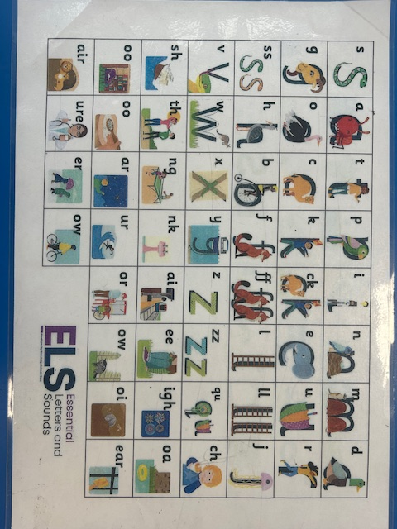
Notes:
Me –you introduce digraph, 2 letters one sound
Digraphs and trigraphs

Slide 8
Phonics and Reading
Blending for reading:
sit pan hat
Reading books will match the sounds children have been taught
The expectation is that children will be able to decode and read every word in a book they are reading
Decodable words sound the way they are spelled
Harder to read and spell words do not sound how they are spelled

Slide 9
Reading at home . . .
Reading at home has a positive impact on children’s reading, both you reading to them and them reading to you.
Your child will bring home:
Reading record – for us and you to record reading
Story book from class book box
Decodable reader – matches phonics taught in class (read up to 4 times a week) changed once a week.
Children will start with a book with no words. The focus is to use the pictures to tell the story.
Decodable books will be sent home once your child is beginning to blend sounds to read words.
Tapestry videos of the sounds taught
Notes:
Word reading and comprehension two parts of reading.
Comprehension through shared reads
Phonics books less comprehension at this stage but you can still use pictures etc to help

Slide 10
Reading in school . . .
Daily phonics
Shared reading
Extra reads and extra phonics
Reading in discovery time
Reading as part of a small group with an adult.

Slide 11
Phonics and Writing
Children will learn to segment words. This is the process of breaking words into their sounds and children writing what sounds they can hear, using their phonic knowledge e.g. dog segmented is d-o-g. This is rehearsed orally before expecting children to write the sounds.
Initial sounds
Final sounds
Robot arms
Sound fingers
Harder to read and spell words
Use of phonic knowledge (not correctly spelt) e.g.
I saw a big green house could be I sor a big grin hows

Slide 12



Drawing Club
Writing in Reception
Immerses children in stories
Share a broad range of vocabulary and a love of language
Develops children's creativity and imagination
Uses picture books, traditional tales and TV cartoons
The children create drawings then come up with a written password and a code. Starts as a mark, sound, word then captions and sentences as the children's skills develop.

Slide 13


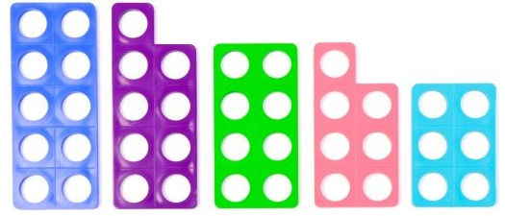
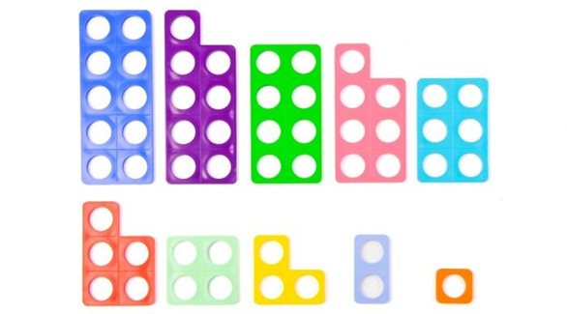
Maths – Key Skills Taught
Subitising – instantly recognise a small quantity, without needing to count how many there are.
Number bonds – pairs of numbers that make 5.
5+0 4+1 3+2 2+3 1+4 0+5
Double facts:
Composition – knowing that numbers are made up of amounts
Part/whole.
Compare quantities.
Shape
Counting beyond 20
Measure

Slide 14
Topics Over the Year
I'm one of a kind.
Changing all around me.
Weather, water and wild places.
Nature detectives.
From city to sea.
A world full of wonders

Slide 15
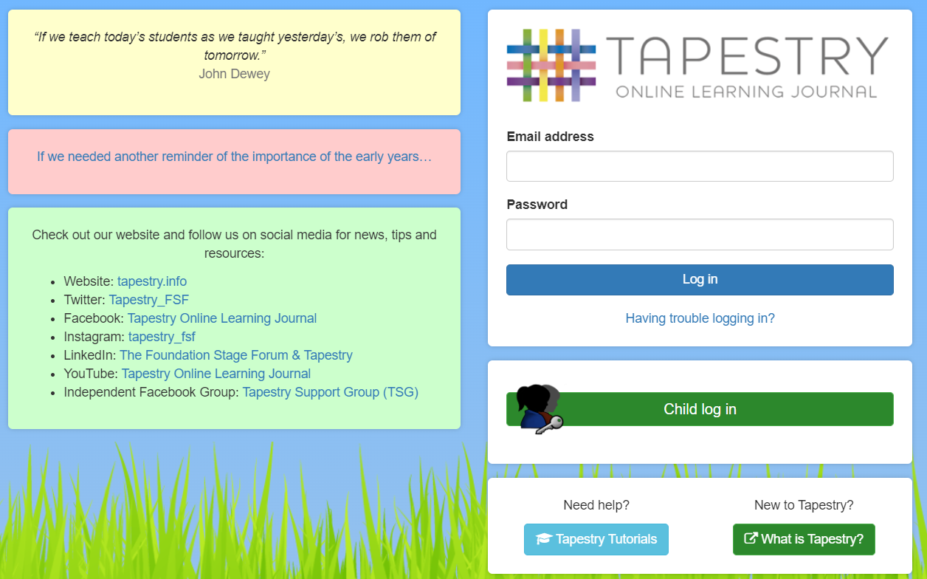
Tapestry
Online learning Journey
Used in school to record children’s ‘wow’ moments or ‘next steps’ in their learning
Phonics videos
Share our learning
Whole class achievements
Communication tool
Updated to journal once a half term
Please share your learning from home

Slide 16

Rainbow of Respect

Slide 17

Golden Tokens
Awarded for positive behaviour over and above our non-negotiables, for displaying any of the Rainbow of Respect behaviours.
Can be given during lessons when children have shown progress, achieved beyond the learning objective, tried hard – above and beyond usual class expectations.
Reading at home – when you read at home and write in the reading record, your child will receive a token for each read (1 per day).
Each week the winning team will have the class trophy with their colour in it. When we start going to assembly the winners from each class sit on the bench!

Slide 18
Partnership with families
Speak to teachers at the classroom doors – morning or afternoon
You can email your child’s class teacher with any concerns/questions you have - teachers are unlikely to check emails between 8.35-3.10 (Aim to be answered within 48hrs)
Keep us informed of any change in home circumstances​
Let us know by letter, email or phone the office if any dropping off or collection arrangements change​
Tapestry
Website – sync calendar​
Medication – if your child needs medication in school e.g. inhaler, antibiotics, prescribed cream. Please make sure they are handed to the office and a form completed.

Slide 19
Just a few reminders . . .
Wellies and waterproofs
Water bottles and jumpers – names/identifying stickers. No squash
Donation station
Please do not put water bottles in book bags - £5 charge for lost or damaged books or a replacement book.

Slide 20
Thank you for coming. Any Questions?
oak@meath-green-infant.surrey.sch.uk
ash@meath-green-infant.surrey.sch.uk
beech@meath-green-infant.surrey.sch.uk

