Slide 1

Understanding emotions and ways to support our child
Gemma Gay – Schools Project Officer

Slide 2

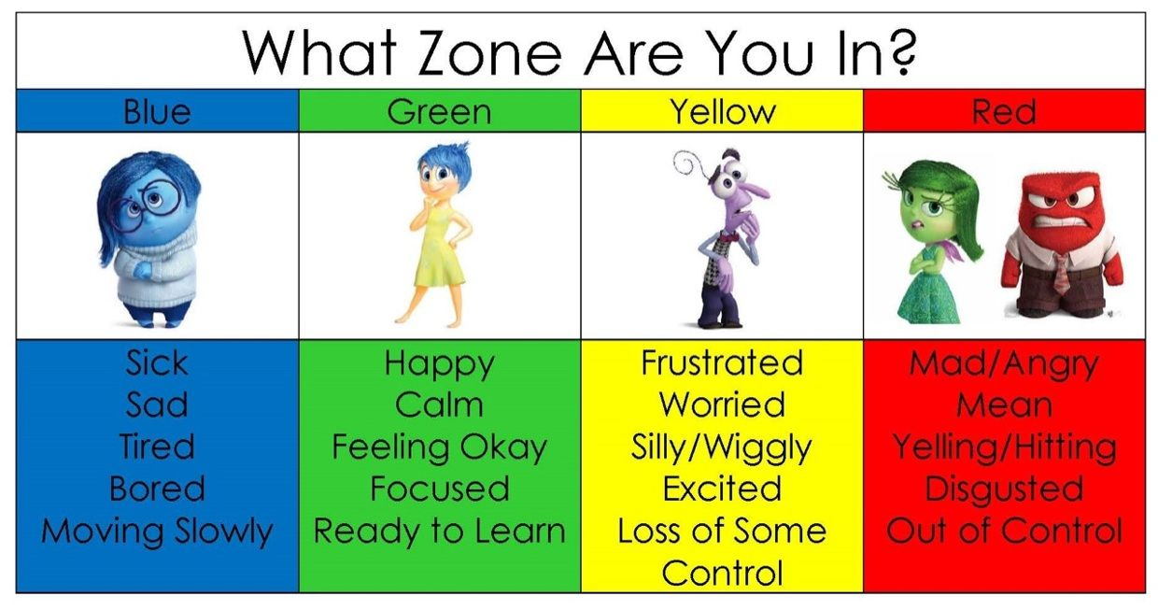

Slide 3
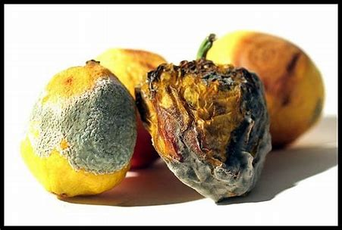
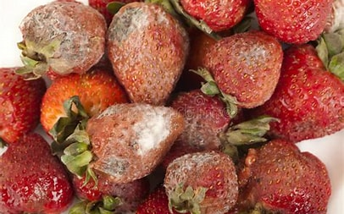

Slide 4
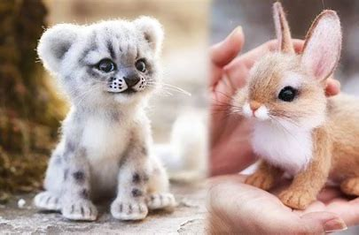
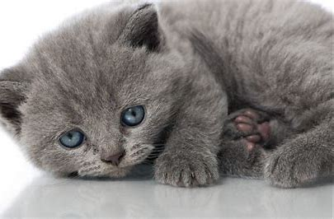
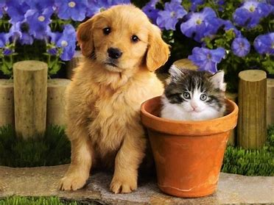

Slide 5
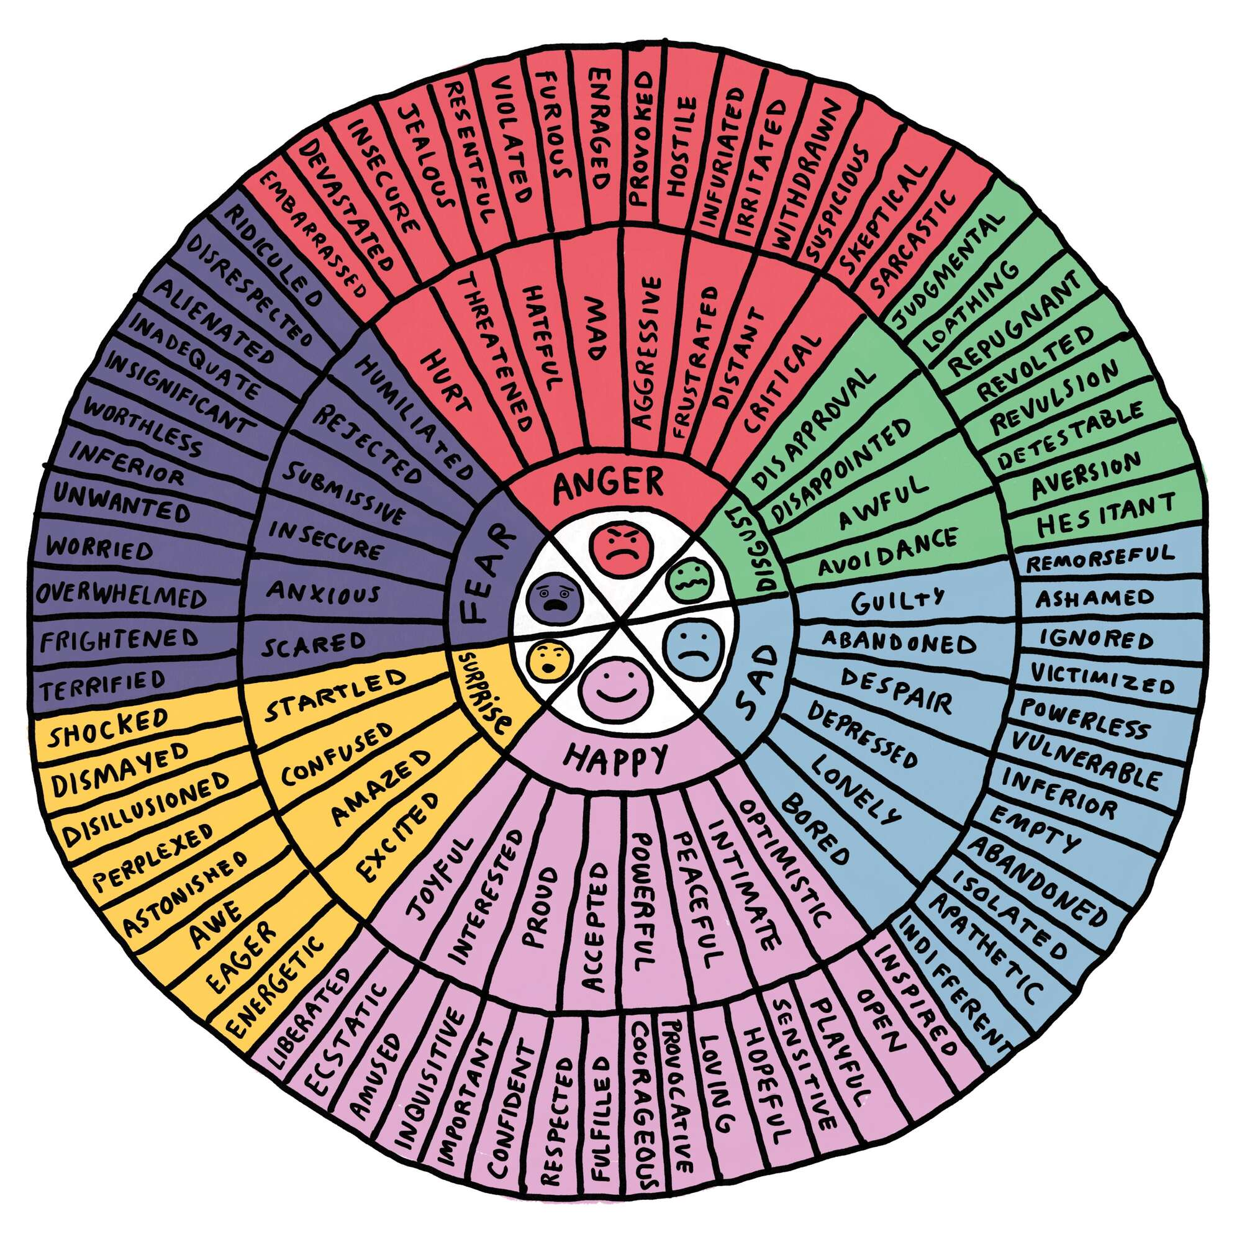
Emotions
Emotions are powerful and can feel overwhelming at times.
We experience a variety of emotions & can feel more than one at a time
Feelings are individual responses to emotions.
Feelings can be influenced by thoughts, opinions and memories
Some emotions are ‘comfortable’ while others can be ‘uncomfortable’.
Why is it important to recognise and understand our emotions?

Slide 6
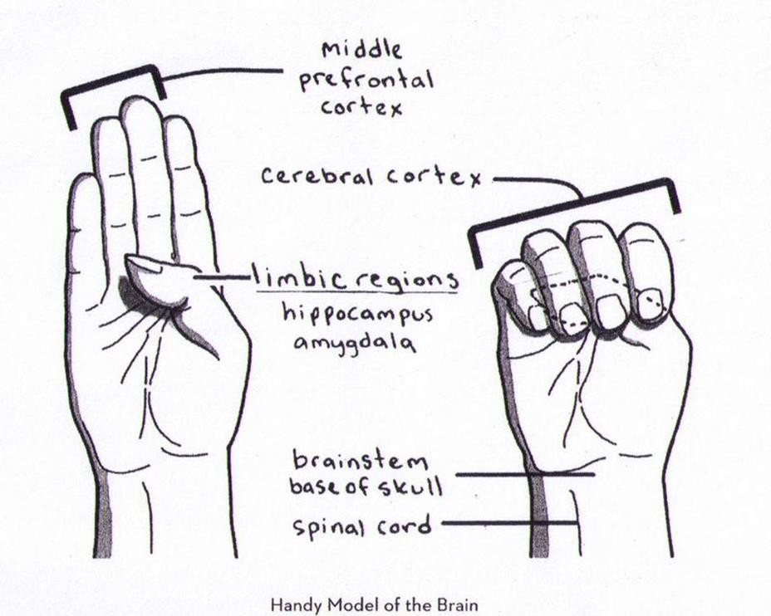
Hand model of the brain (Siegel 1999)
Copyright © Surrey Educational Psychology Service, 2019

Slide 7
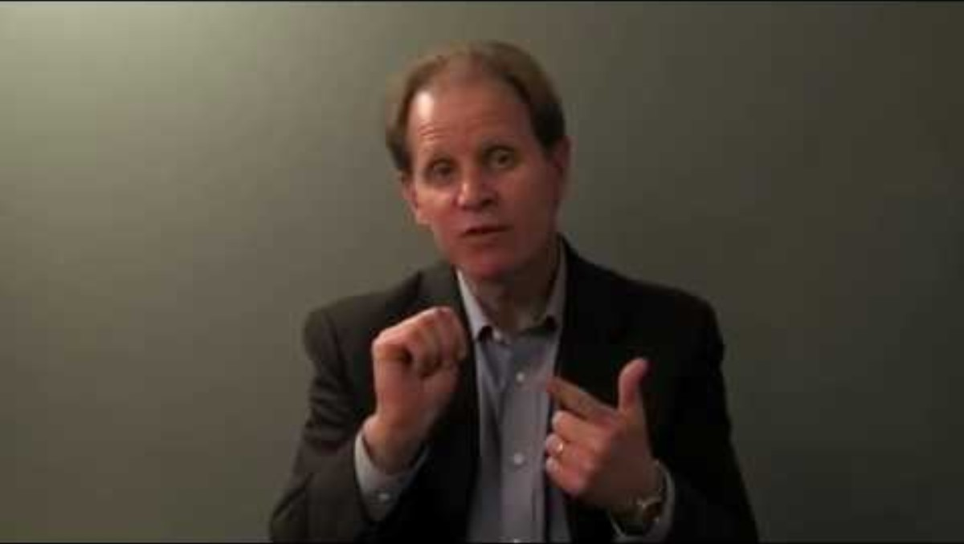

Slide 8
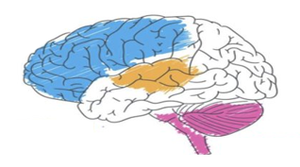
Emotional regulation and the brain
Limbic system:
Emotional Brain/mid-brain/monkey brain
Cerebral Cortex:
The thinking/rationale brain
This part of your brain is responsible for regulating your emotions.
Houses the Hippocampus and Amygdala
Flight or fight response
Pleasure and reward
Responsible for higher functioning
and deep thinking.
Houses the pre-frontal cortex it controls stuff like:
Reading, Writing, Talking & Listening
Critical thinking, Problem Solving
Social-relations
Concentration
Organisation & Decision Making
Reasoning & Judgement
Creativity
Emotional regulation
Brain stem/Reptilian brain/Ancient brain/Survival Brain
Responsible for keeping you alive.
It controls basic body functions like:
Heart rate
Breathing
Body temperature
Sleep/wake cycle
Immune system
Freeze response
Movement

Slide 9
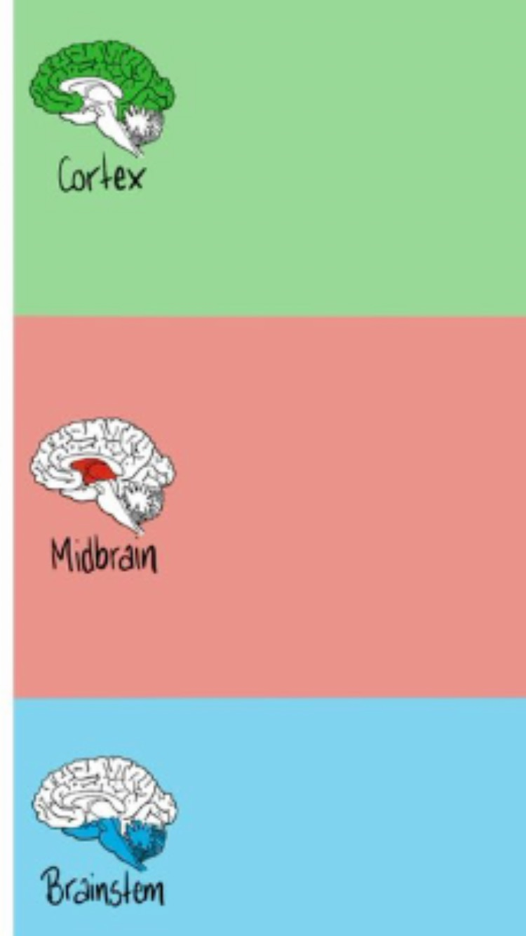
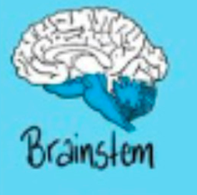
Hyperarousal
Red Zone/ /Flight/
Fight
Can’t calm down
Green Zone / Ready to learn
Window of Tolerance
Shut down
Blue Zones /Freeze
Hyperarousal
Window of Tolerance

Slide 10

Red Zone/ Hyperarousal/Flight/
Fight
Yellow Zone- Can’t calm down
Green Zone / Ready to learn/ Window of Tolerance
Yellow Zone- Can’t calm down
Blue Zones Hyperarousal /Freeze

Slide 11
Window of Tolerance
Angry/rage/Anxious/ Aggressive/out of control/ overwhelmed Fight/Flight response/ Impulsive
Hyperarousal
Can’t calm down
Start to feel agitated, anxious, angry. Feel uncomfortable but not out of control
Window of Tolerance
Cool/Calm/Focused/Present/Alert/think clearly/ Manage life's challenges/balanced
Shut down
Start to feel overwhelmed/Lose track of time/ not out of control but don't feel comfortable
Hyperarousal
Numb/Empty/Hopelessness/not present/exhausted/Depressed/ Shutting down

Slide 12
Triggers/ Cause
Being triggered means that you experience a strong negative emotional reaction in response to a current situation that is disturbing to you in some way.
This could be conscious or unconscious ( depending on life experiences)

Slide 13
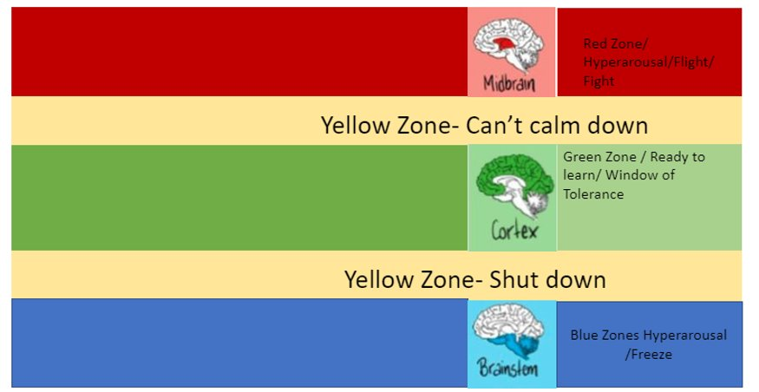
Chaotic
Not listening to instructions
Hiding
Controlling
Angry/Rage/Aggression
Flight/Fight
Thoughts are out of control
overwhelmed
Agitated/ anxious- Do not feel comfortable but not out of control
TRIGGERS
Focused
Reaction adapt to suit situations
Curious
Can deal with challenges
Interested
Playful
Calm/Balanced
TRIGGERS
Agitated/ anxious- Do not feel comfortable but not out of control
Confused
Daydreaming or staring into space/zoned out
Numb
Can’t think
Low mood/depression
Shame
Disconnected
Empty/no emotion

Slide 14
Behavior displayed by children that might be in Fight/Flight
• Keeping super busy
• Running away
• Constantly asking to go to the toilet
• Constantly asking to get something l something located
outside of the room being used
• Hiding under tables
• Head on the desk
• Not coping in free time or able to follow school rules
• Need to be first or at the front
• Aggressive, clenched fists, threatening
• Bumping into people
• ‘Hyperactive’, giddy & silly
• Hot and bothered
• Aggressive, angry
• Argumentative, shouty
• Controlling
• Demanding, inflexible
• Lying or blaming
• Can’t concentrate
• Pushing people away
• Not ‘fitting in’
• Loner
• Immature
• Loud, noisy and disruptive
• Disrespectful
• Confrontational

Slide 15
Supporting Emotional Regulation...
Model self-regulation
Be supportive and encouraging.
Collaborate and make learning about regulation fun.
Teach children about their brains.
Expand their emotional literacy & vocabulary
Enhance their self-awareness
Help children identify opportunities to practice their skills.
Give immediate and specific feedback.
Use rewards, positive reinforcement, and praise.
Help them develop a toolbox of coping strategies

Slide 16
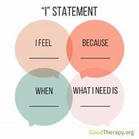
Modelling
Feelings

Slide 17
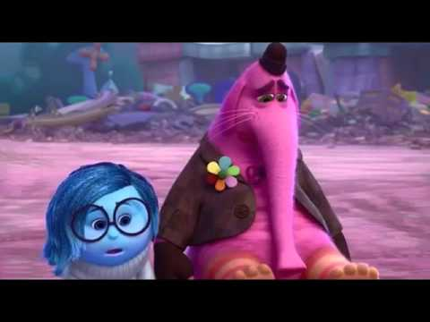
Normalising and acknowledging emotions and feelings
Notes:
Expanding emotional literacy
Being supportive

Slide 18
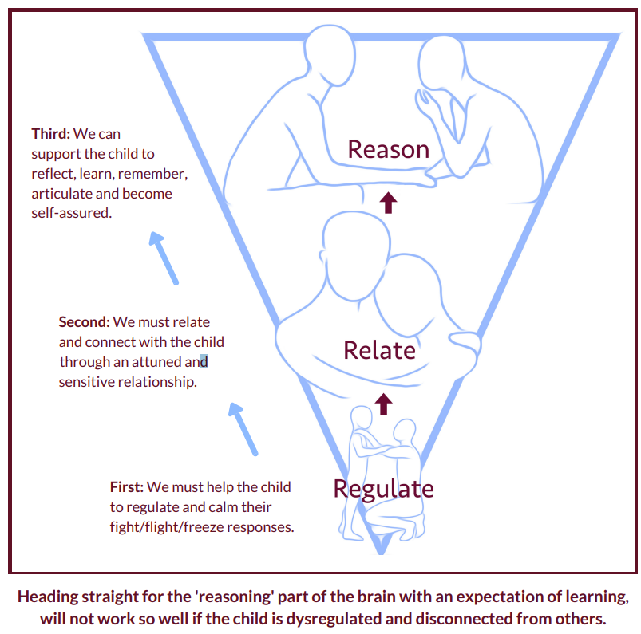
Bottom-up approach
Until a child is regulated, they are unlikely to relate to you (feel comfortable and connected) and until a child is related, they are unlikely to have the mental capacity to reason with you

Slide 19
Step #1: Stay grounded (regulated)! Stay in the present moment, breathe steadily, focus your attention on your child, and clear your mind. If you yourself have a difficult time regulating yourself then grounding techniques might be helpful.
Step #2: Get down on their level. Nothing signals the brains threat alarms than something big and tall looming over us. Remember in this heightened state for your child everything appears larger so by getting down to their level, eye level, you immediately take that threat away.​
Step #3: Regulate-Focus on soothing. Since your child is in the lower parts of their brain trying to reason with them won’t work. At this stage you’re all about making them feel calm, safe and loved. Think about your tone of voice, be curious as to what’s happening. ( try not to focus on their behavior) What do they need to feel safe.
Step #4: Relate. As they calm down use short sentences. You can validate their feelings with your words and tone of voice while also providing them with a hug or even taking their hand. Use short sentences such as “I know you feel upset right now, this is very hard”. Your focus here is connecting with your child.
Step #5: Reason. Once your child is all the calm, now is the time to talk about alternatives to their behaviors while still reinforcing the limit you set before. You can reassure them that you live and care about them but the behavior they are exhibiting is not ok.

Slide 20
Talking Strategies
Curious questioning
Encourage the child to explore their feelings
WIN Strategy
I Wonder…
I Imagine…
I Notice…
Always remain curious​
What might my child be thinking?​
Have I missed anything?​
Is there another way to think about this?
Notes:
What happens if your YP struggles to name their feelings
Curious questioning can help – make tentative suggestions with the WIN strategy
Find the right time to talk – maybe on a dog walk or in the car to take the pressure off

Slide 21
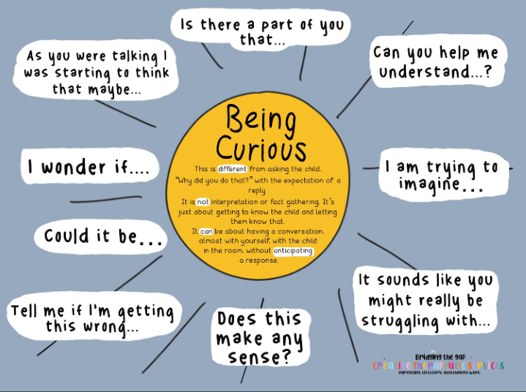
Notes:
Make suggestions
Sometimes, your child might answer with 'I don't know' - so what next?
Do you think you're upset about...?
Some children worry that...is going to happen, do you think you are worried too?
Try to use 'what' instead of 'why' eg instead of 'why are you upset?' Try 'what has made you upset?'
Keep trying!
Check Understanding
Check you understand with clarifying sentences. 'Have I understood right that you're struggling with...'
Pick your moment.
Sitting and talking can be difficult. Shifting the focus can help for example, talking in the car or out for a dog walk.
It may take time to help your child express themselves.

Slide 22
Sample activities to decrease arousal include:
Diaphragmatic breathing (deep and slow tummy breathing)
Drinking from a straw
Throwing a ball at a blank wall or outside wall
Something rhythmical (such as dancing, rocking on a hammock, a swing, or gently bouncing on a trampoline or mini trampoline
Climbing/hanging
Shaking or stomping out excess energy
Heavy work (lifting, pulling, push ups, wheelbarrow races, crab walk, leap frog etc.)
Music (soothing and calming music and sounds)
Comforting food (hot chocolate or something chewy)
Brainstem Calmer Activities (beaconhouse.org.uk)

Slide 23
Sample activities to increase arousal include:
Anything that stimulates the senses or body!
Smelling essential oils (smell is the fastest way to the thinking brain - where the strategies are!)
Chewy crunchy food
Use of sensory shaker (ball pit) for tactile input
Movement
Jumping on a trampoline or mini trampoline
Gently sitting and bouncing on a ball (simulating rocking motion)
Rocking chair
Weighted blanket
Finger painting
Water play with a straw (blowing through the straw)
Dancing and music playing an instrument
Grounding exercise

Slide 24

Breathing Technique
4
6

Slide 25
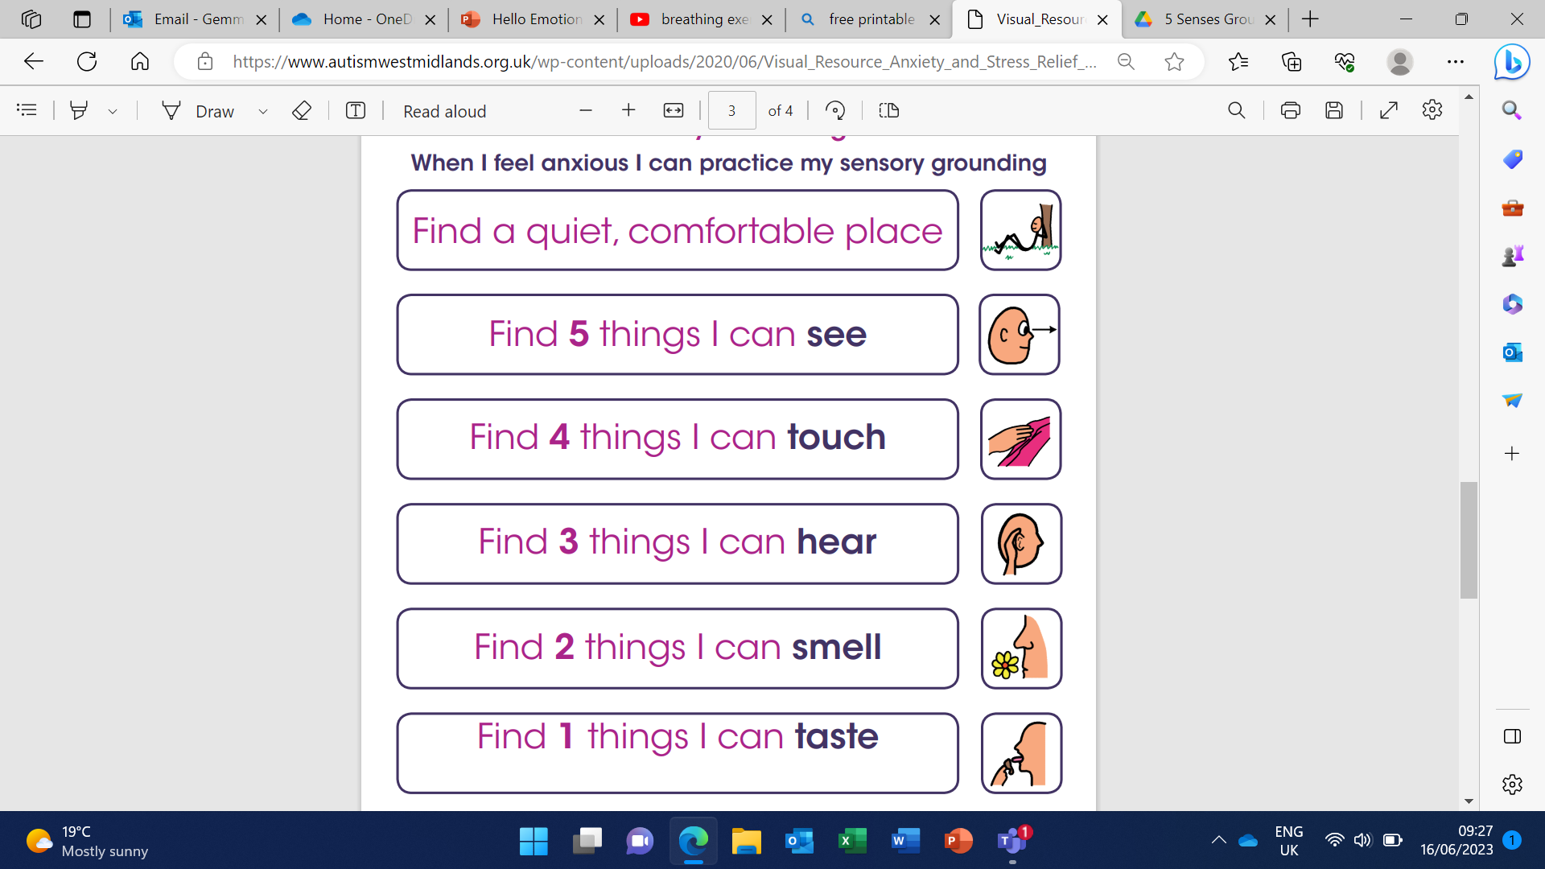
Grounding Technique

Slide 26
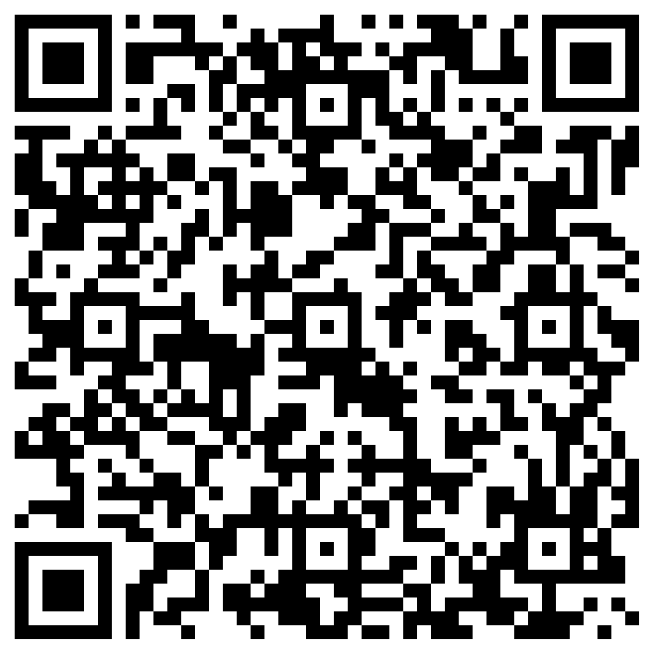
Staff training feedback

Slide 27


